Slide 1

Notes:
Someone does introduction (Needs to be good)

Slide 2
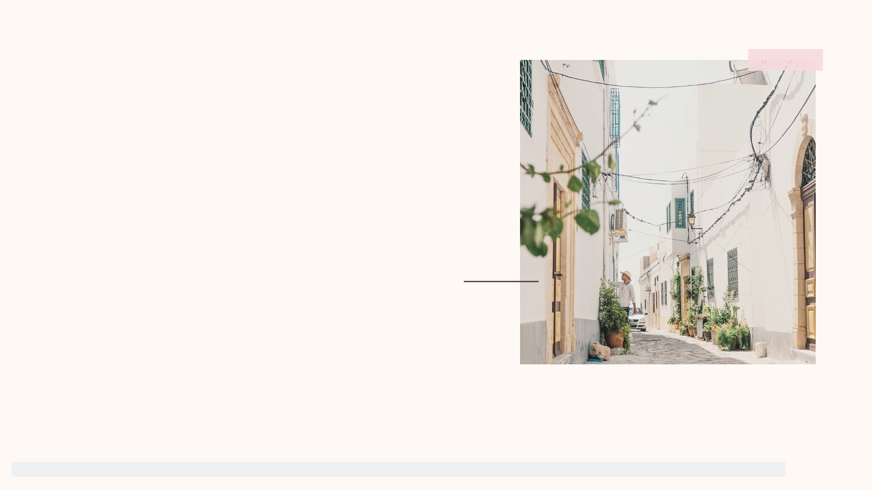
Recap
Surveyed 74 People
Interviewed 11 people (6 female, 5 male)
Narrowed down audience to college students (in our case, U of I)
Narrowed down topic to accessibility
Identified the areas of focus which require maximum attention to help women regarding reproductive health
Notes:
ME

Slide 3
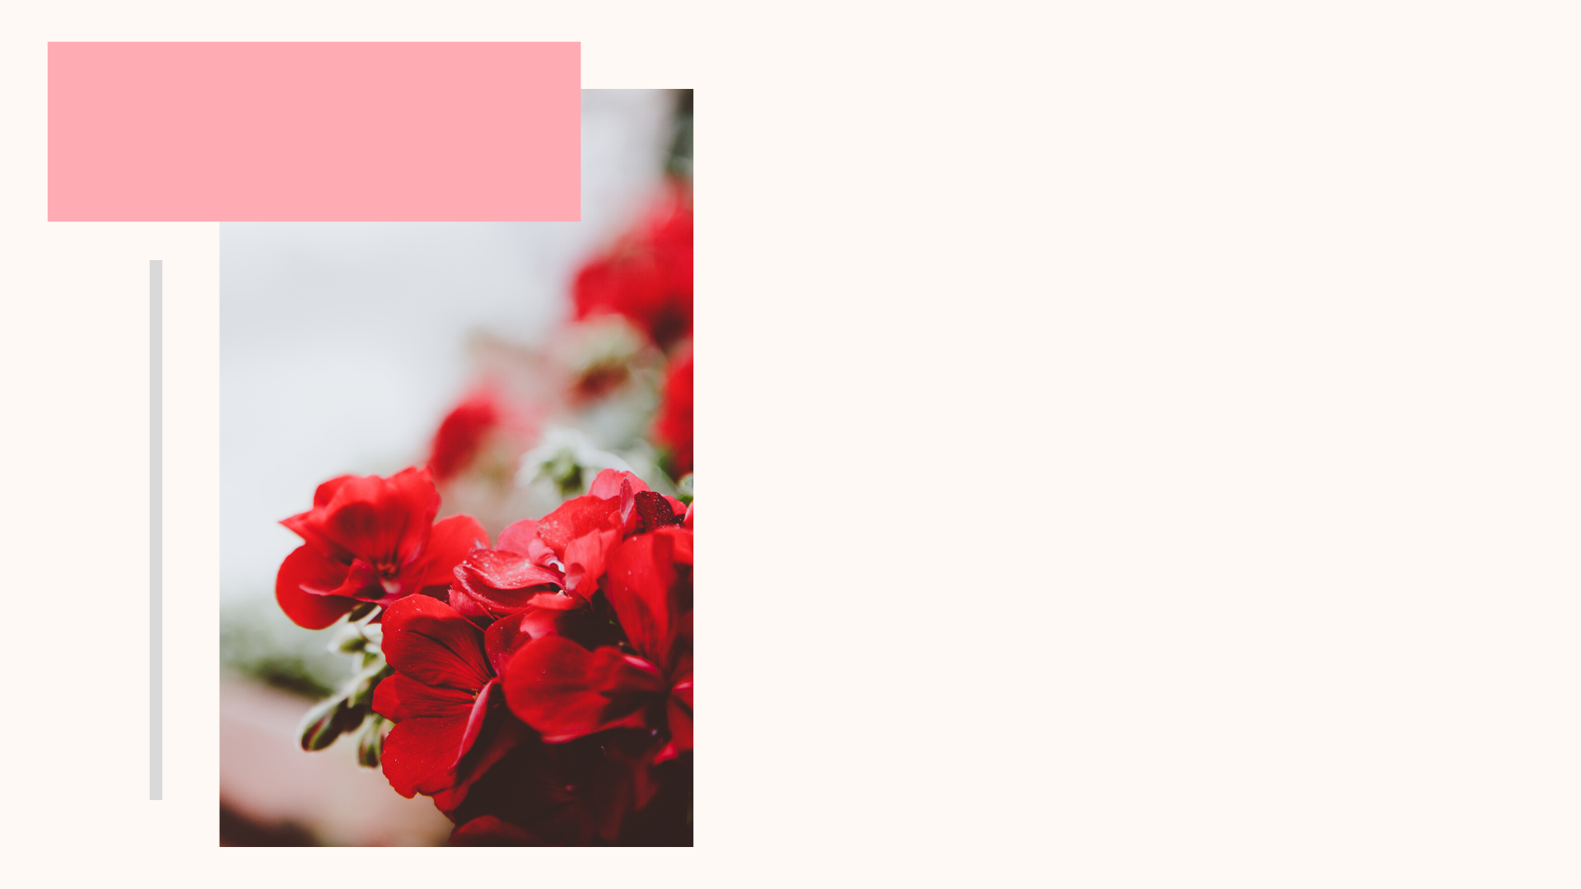
Goals
Our goals are to educate those with periods about how to take care of their reproductive health, and help increase accessibility of sanitary products. We also want to find ways to improve the awareness regarding sanitary products, and research what solutions are already available and figure out how to optimize them.

Slide 4

Behavioral
Frameworks
2 x 2

Slide 5
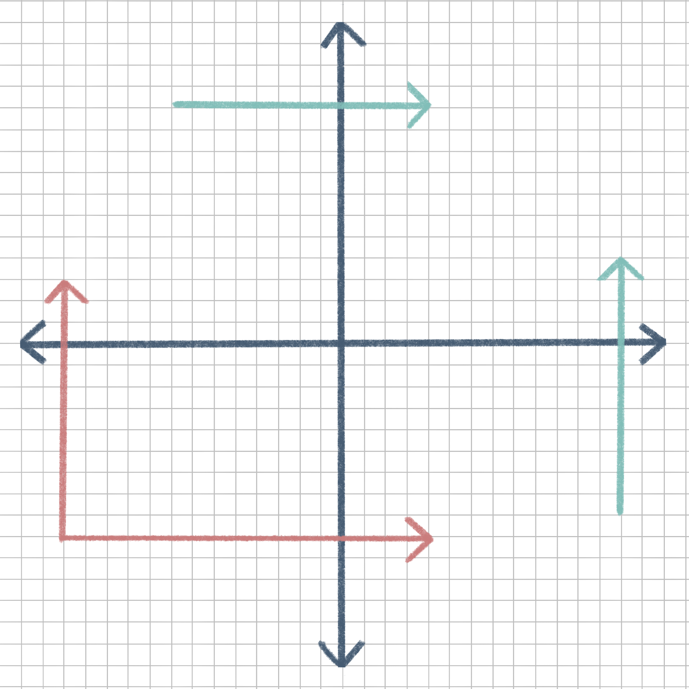
High Brand Trust
Brand Trust
Vs.
Quality
- Research Encouragement
- Eco-friendly solutions
Low Quality
High Quality
- Provide Quality
- Increase # of pads in a packet
Key:
Female Interviewees
Male Interviewees
Low Brand Trust
Notes:
Less time

Slide 6
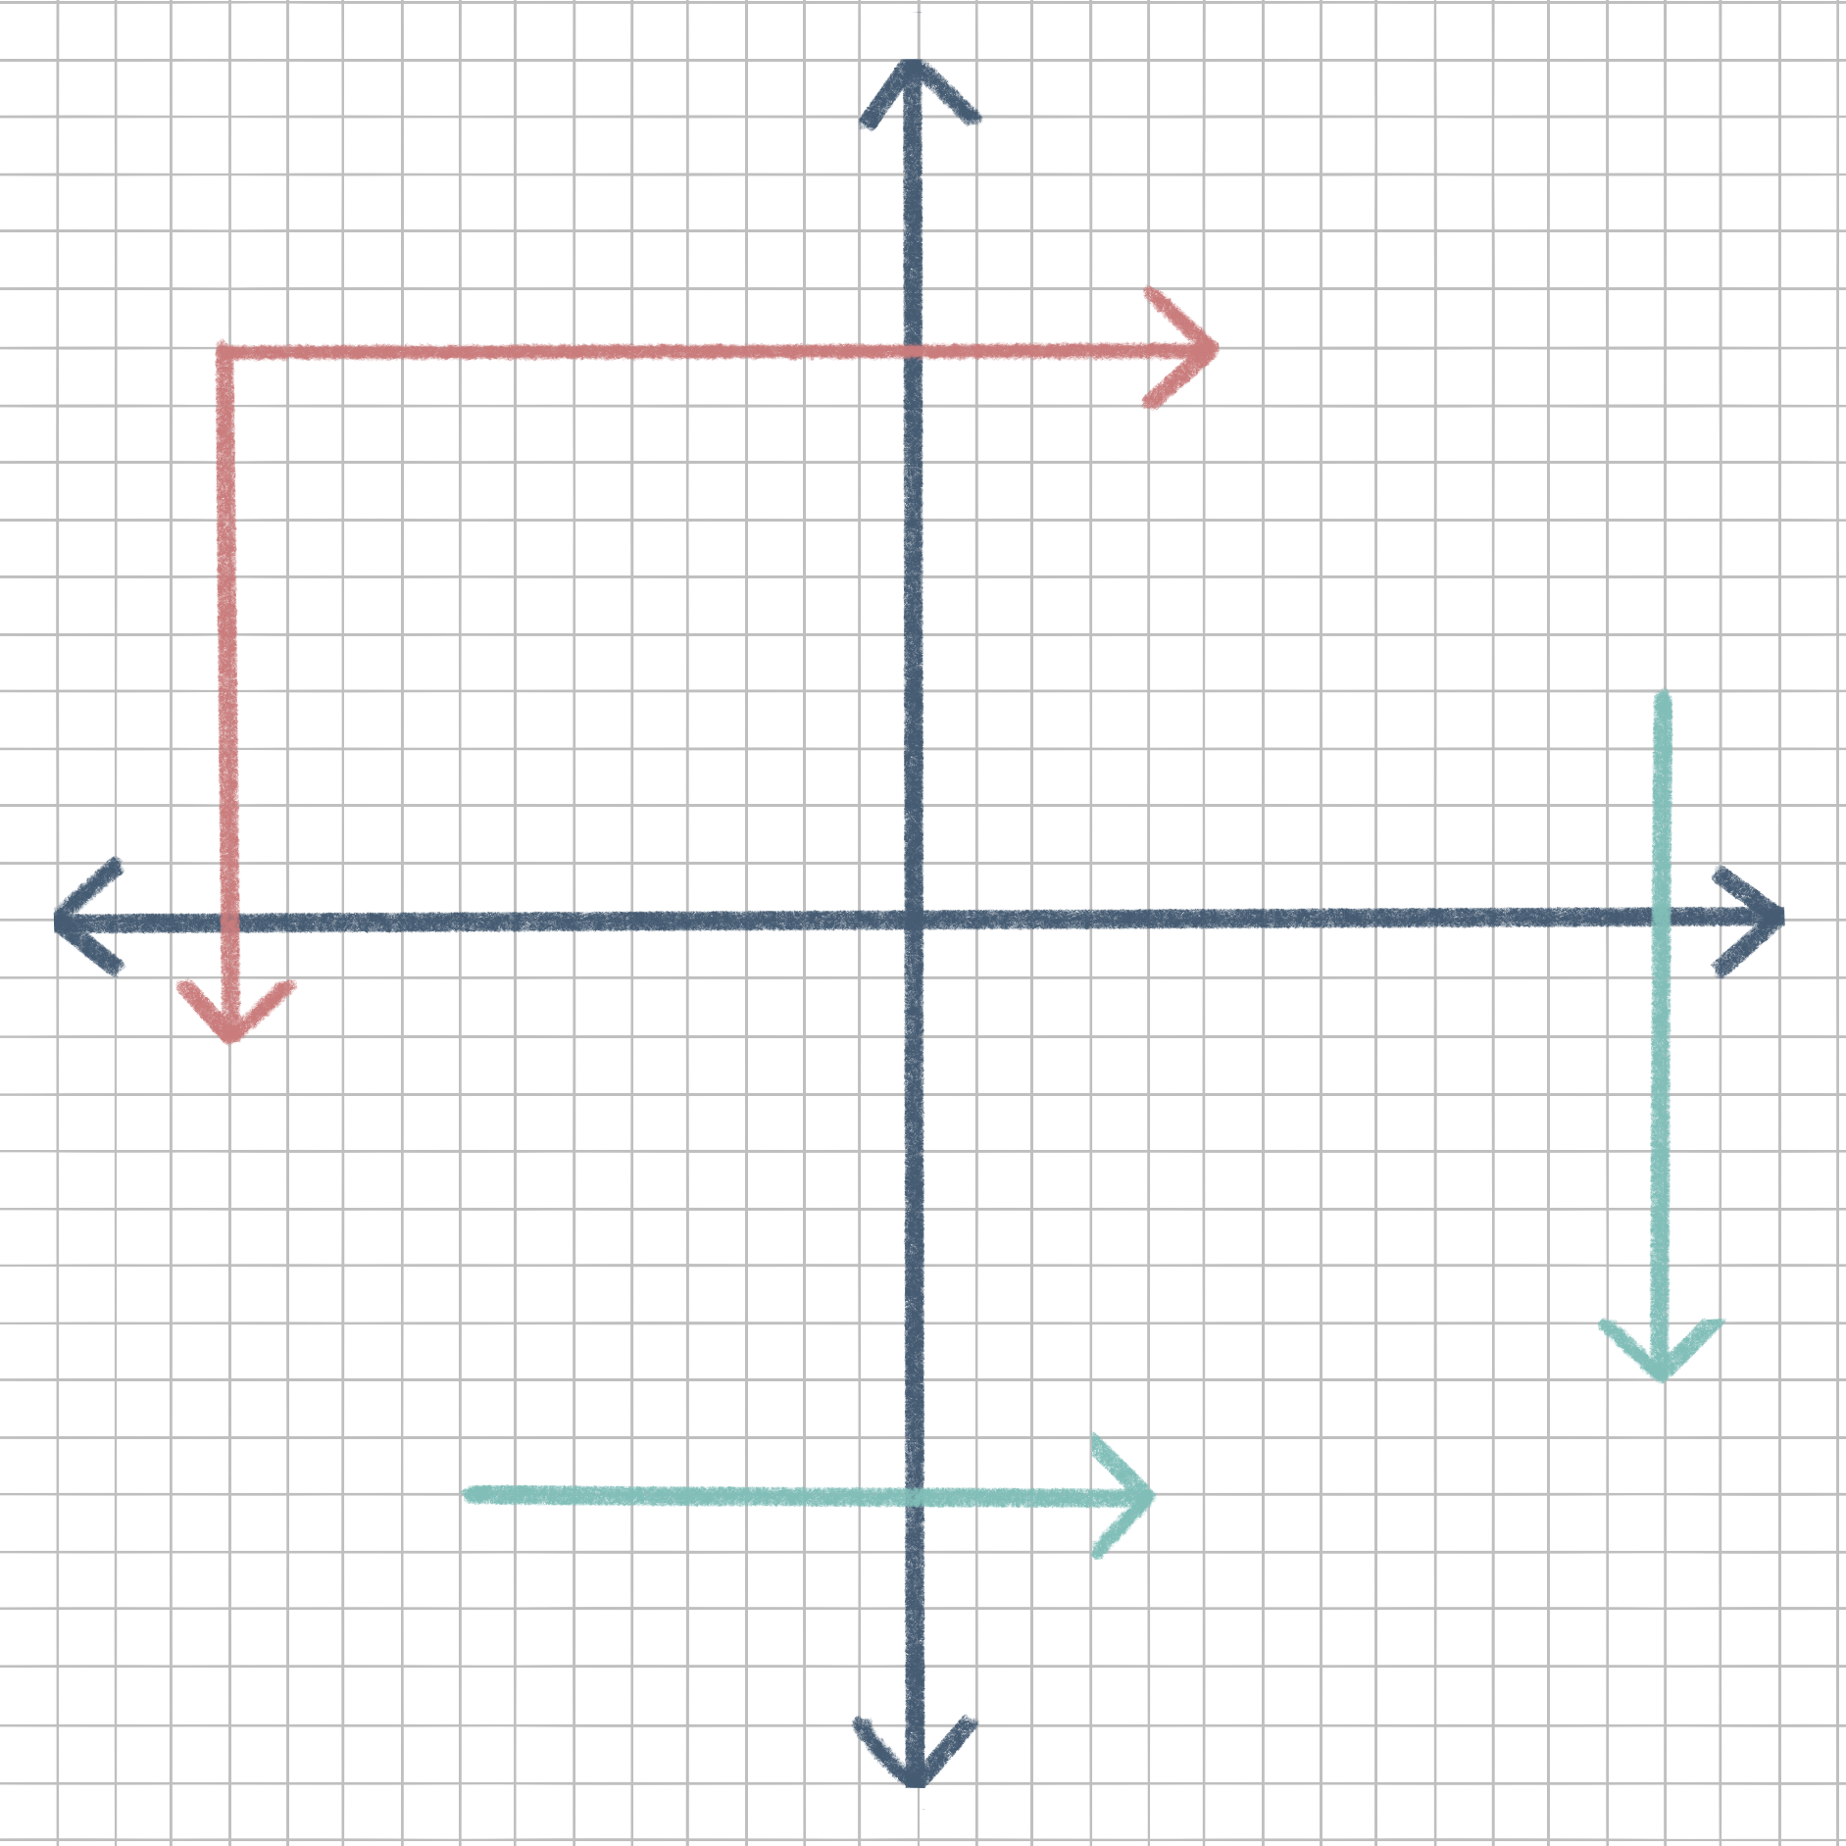
High Misuse
Misuse
Vs.
Cost
Low Cost
High Cost
- Put cap on
- Monitoring
- Ban Tampon Tax
- Tampon stamps
Key:
Female Interviewees
Male Interviewees
Low Misuse
Notes:
Less time

Slide 7
High Access
Access
Vs.
Awareness
- Early Education
- Workshop Drives
Low Awareness
High Awareness
- NGO
- University-free Access
Key:
Female Interviewees
Male Interviewees
Low Access
Notes:
Most time

Slide 8
Opportunity
Areas

Slide 9

Opportunity Areas
1
2
3
4
Research on Environmentally Friendly Sanitary Products
Encouraging researchers and students through funding and workshops
Increase awareness and accessibility about the available products and their pros/cons.
Move forward in society as well as local community

Slide 10
If more people are aware that something exists, they will have increased accessibility to it since they know it exists.
Key Insights
To “move” to the most optimal quadrant in the framework, the easiest way to raise awareness is by implementing educational workshops and resources.
Level of awareness varies by gender. Our male interviewees were much less of the female participants, so it would be interesting to explore how to combat this issue.
Notes:
ME

Slide 11
Concept
Ideation

Slide 12


PLANNING
1) What already exists on campus?
2) How can we optimize what already exists?
3) What is feasible?
DESIGNING
1) 2 by 2 Behavioral Framework
2) Capability Approach
Identify the factors which the target audience values, restrictive freedom and try to eliminate it, the real users of your product
3) Racialized Designs
DEVELOPMENT
1) Sanitary Products’ Company Collaboration
(Bulk Buy)
(Brand Rep.)
2) Data Analysis
3) Maximum Footfall Area
4) Transport Amendment
5) Preferred Brand and Type 6) Rapid Application Development
Concept Ideation
Notes:
Key insights from frameworks

Slide 13


Slide 15
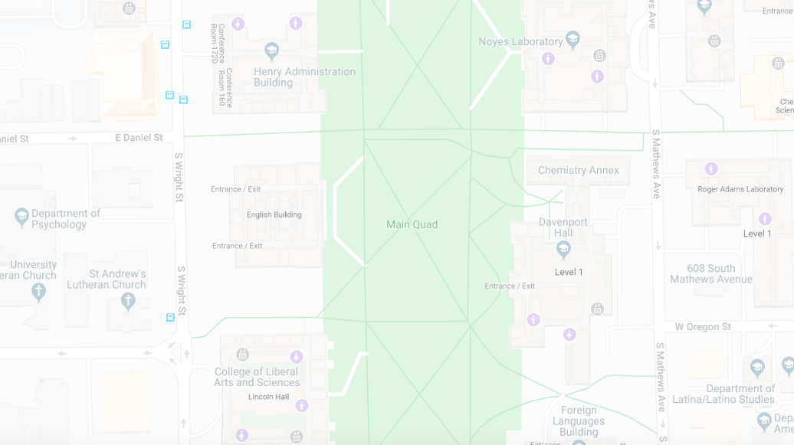

pin Pad

Slide 16
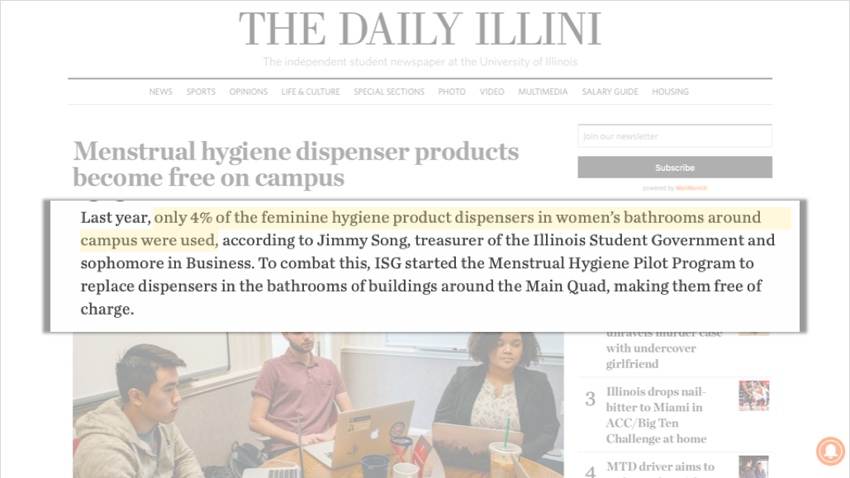

Slide 17
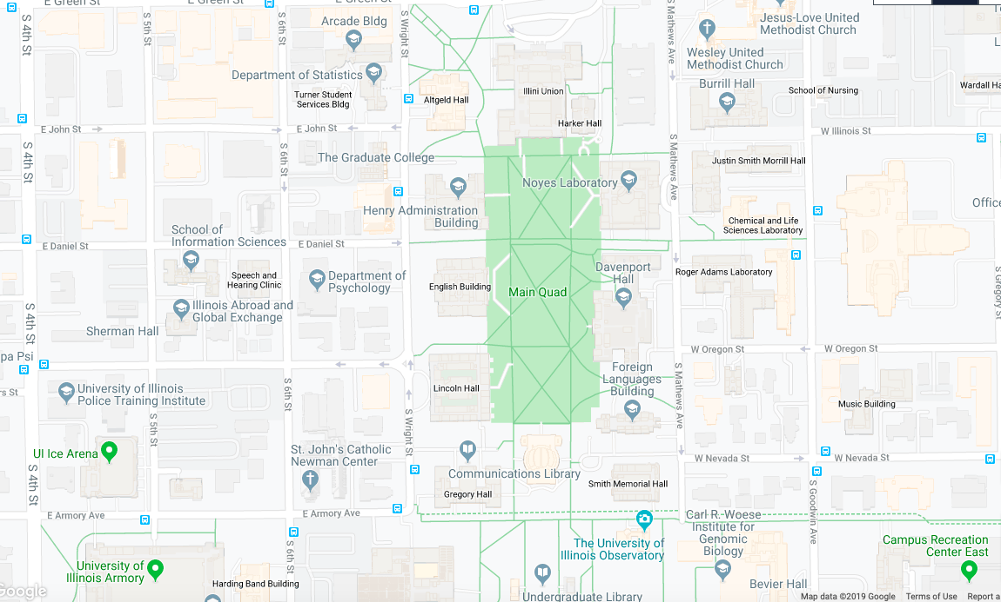
Map courtesy of Google Maps

Slide 18
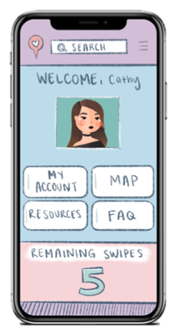
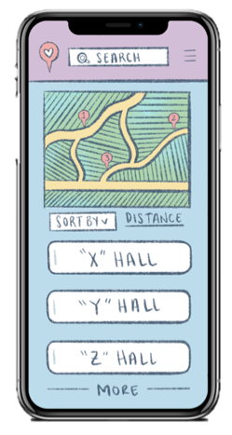
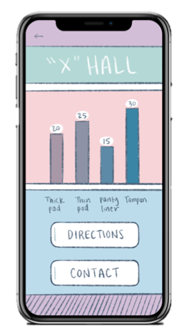
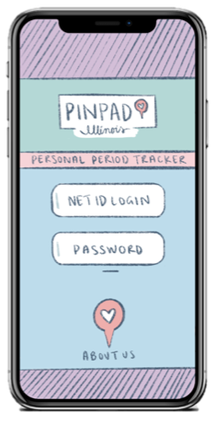

Slide 19
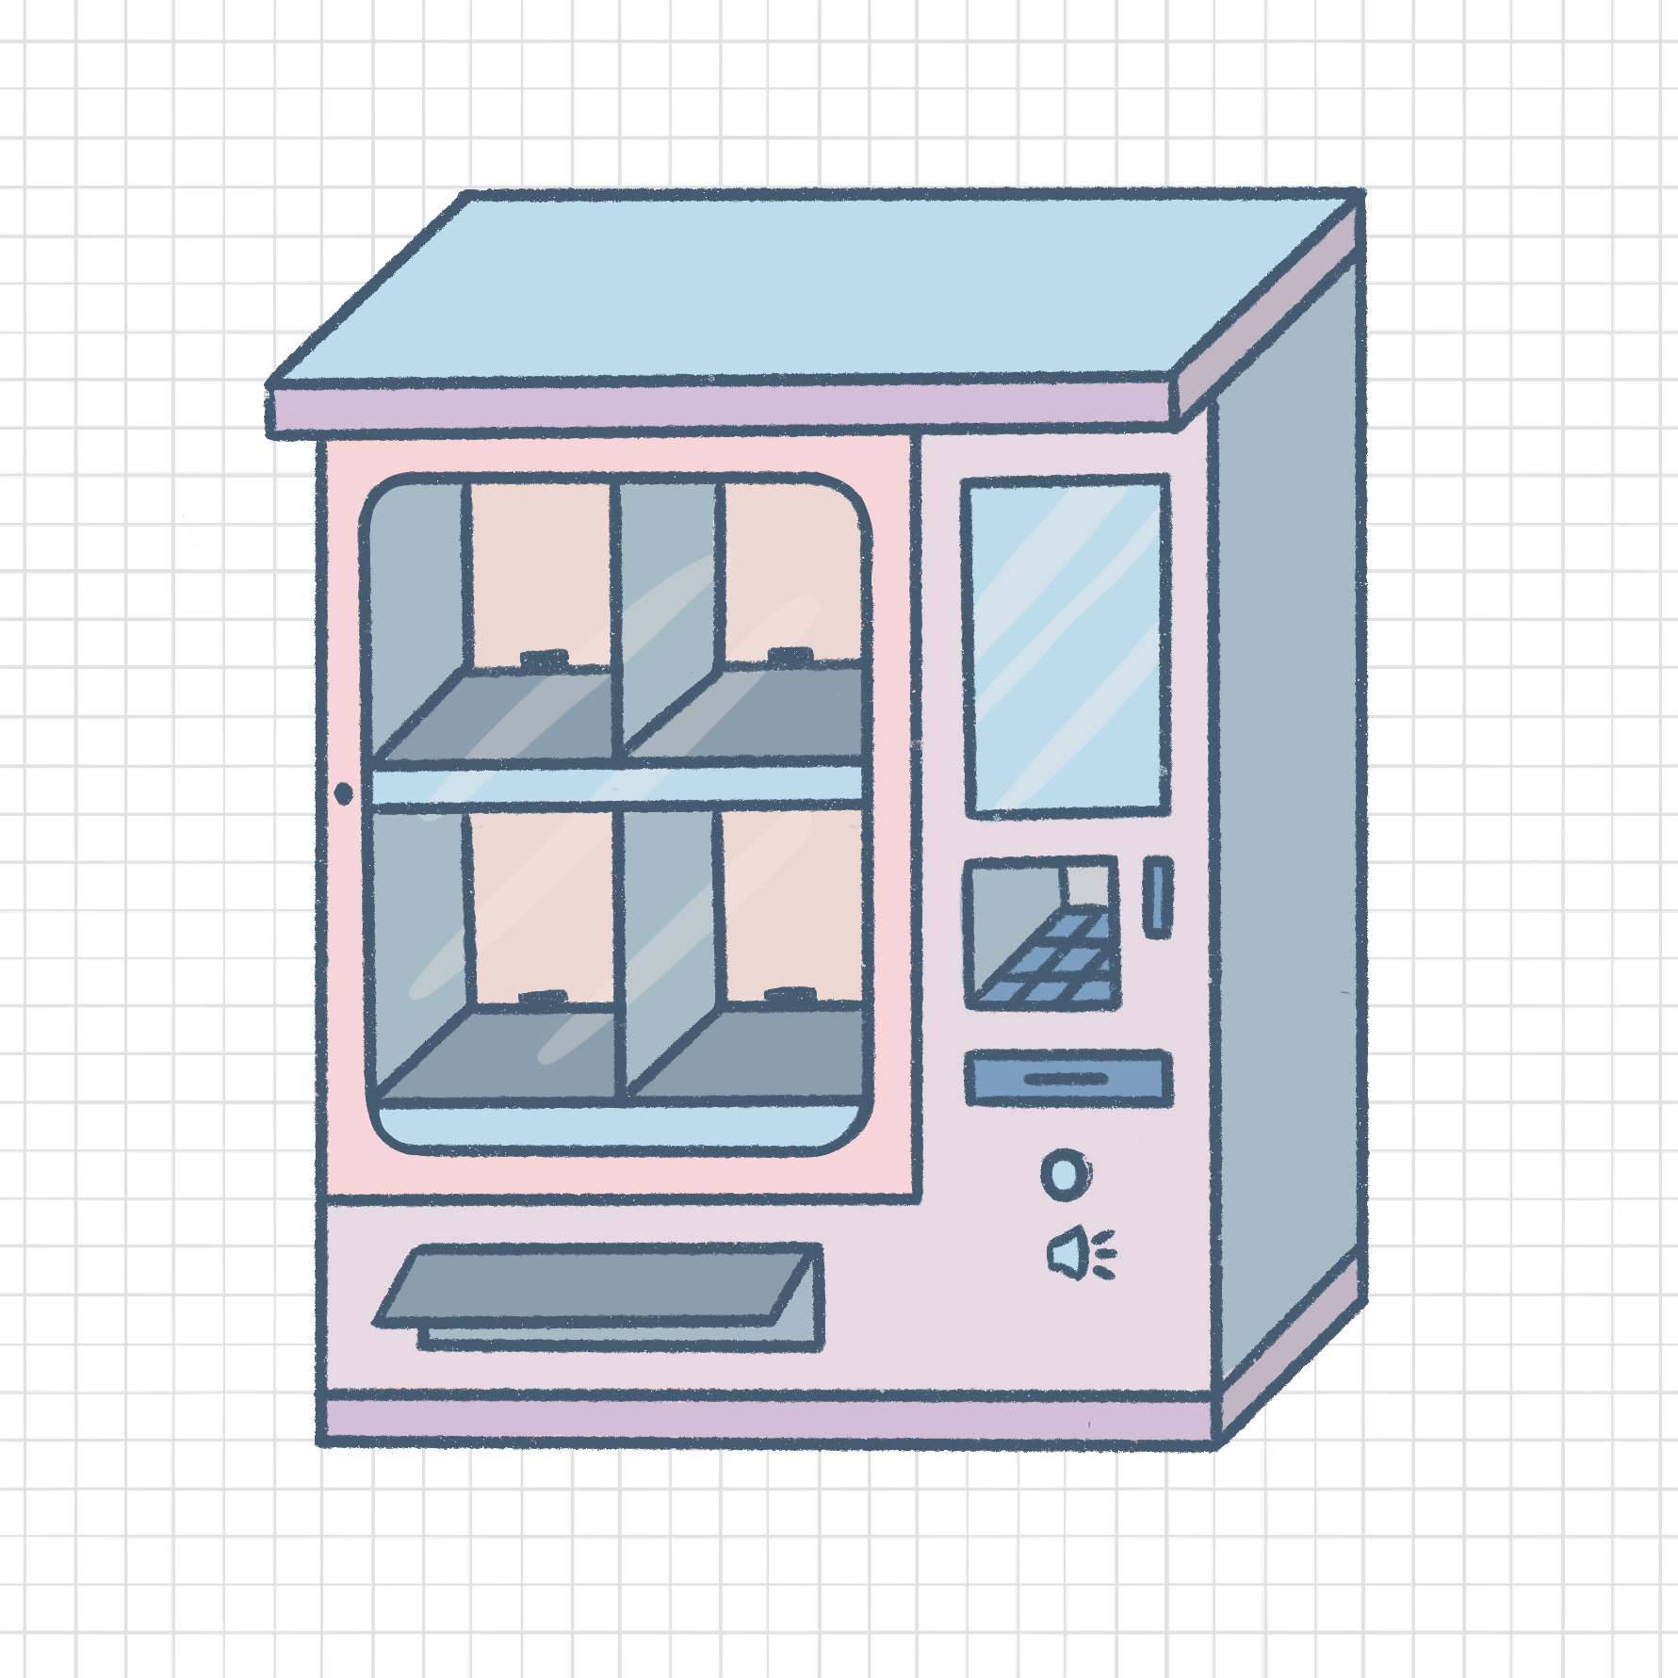
Our
Concept

Slide 20
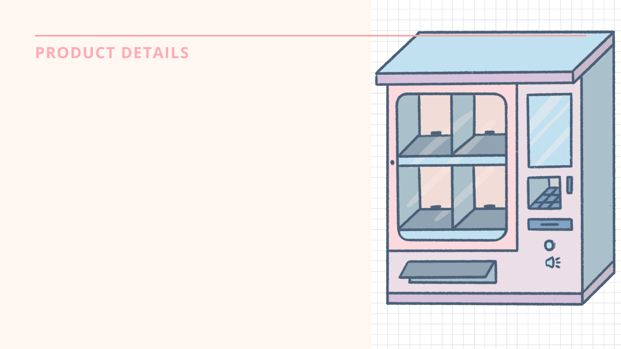
More modern and upgraded look. Restrooms have automatic flushing toilets, high quality dryers, but how about a top of the notch sanitary product dispenser?
More accessible to the disabled community
Creates a welcoming and positive experience for people
Integrating - technology, we will be able to collect data, analyze it, and learn more in detail about the women who use dispensers

Slide 21
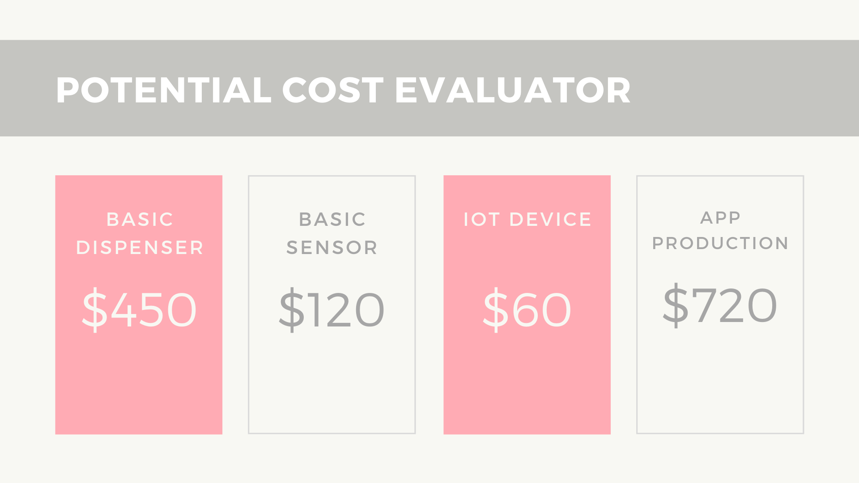

Slide 22
Data Collection & Analysis
By integrating the iCard swipe feature, we will be able to collect data on individual profiles, which will provide a greater insight into the habits of those using the dispensers.
We will be able to answer questions such as:
How many times does an individual use a dispenser within the span of a month? (Analyzing user patterns)
What type of products are the most popular?
How many people utilized the dispenser within a certain time span? (popularity)

Slide 23

CORPORATE SPONSORSHIPS
By creating partnerships with companies, we will be provided with a more powerful platform to create change and take our mission of increasing accessibility to the next level
Future
We could also work with companies to sample various products in the dispensers to see what users like. If dispensers have products catered to individual’s specific needs, it will be a method of increasing accessibility!

Slide 24


